Slide 1


Discrete mathematics and its application
Lamya A. Omer
Lecture1 – part 2
2nd Stage
2020-2021
lamya.omer@uod.ac

Slide 2
Combining Propositions
As we have seen in the previous examples, one or more propositions can be combined to form a single compound proposition.
We formalize this by denoting propositions with letters such as p, q, r, s, and introducing several logical operators.
Logical Operators (Connectives)
We will examine the following logical operators:
Negation (NOT)
Conjunction (AND)
Disjunction (OR)
Exclusive or (XOR)
Implication (if – then)
Biconditional (if and only if)
Truth tables can be used to show how these operators can combine propositions to compound propositions.

Slide 3
Definitions
DEFINITION 1: Let p be a proposition. The statement "It is not the case that p" is another proposition, called the negation of p. The negation of p is denoted by ~p. The proposition ~ p is read "not p.“
EXAMPLE Find the negation of the proposition "Today is Friday.'' express this in simple English.
Solution :The negation is "It is not the case that today is Friday."
This negation can he more simply expressed by
"Today is not Friday," or "It is not Friday today."
Negation (NOT)
P | ~P
true | false
false | true
A truth table displays the relationships between the truth values of propositions.

Slide 4
Conjunction (AND)
Binary Operator, Symbol: ∧
DEFINITION 2
Let p and q be propositions. The proposition "p and q," denoted p˄q. is the proposition that is true when both p and q are true and is false otherwise. The proposition p ∧q is called the conjunction of p and q
EXAMPLE
Find the conjunction of the propositions p and q where p is the proposition "Today is Friday" and q is the proposition "It is raining today."
Solution:
The conjunction of these propositions, p  q, is the proposition
"Today is Friday and it is raining today"
P | Q | PQ
true | true | true
true | false | false
false | true | false
false | false | false

Slide 5
Disjunction (OR)
Binary Operator, Symbol: ∨
DEFINITION 3
Let p and q be propositions. The proposition "p or q," denoted p v q , is the proposition that is false when p and q are both false and true otherwise. The proposition p \/ q is called the disjunction ot p and q.
Compare these two sentences
"Students who have taken calculus or computer science can take this class.“
"Students who have taken calculus or computer science, but not both , can enroll
in this class."
P | Q | PQ
true | true | true
true | false | true
false | true | true
false | false | false
Similarly, when a menu at a restaurant states,
"Soup or salad comes with an entree,"
the restaurant almost always means that customers can have either
soup or salad, but not both.
Hence, this is an exclusive. rather than an inclusive, or.

Slide 6
Exclusive Or (XOR)
Binary Operator, Symbol: ⊕
DEFINITION 4
Let p and q be propositions The exclusive or of p and q, denoted by p  q, is the proposition that is true when exactly one of p and q is true and is false otherwise.
P | Q | PQ
true | true | false
true | false | true
false | true | true
false | false | false

Slide 7
Implication (if - then)
Binary Operator, Symbol: →
DEFINITION 5 Let p and q be propositions. The implication p  q is the proposition that is false when p is true and q is false, and true otherwise.
p is called the hypothesis and q is called the conclusion (or consequence).
"p only if q" expresses the same thing as "if p then q.“ To remember this, note that "p only if q" says that p cannot be true when q is not true.
That is, the statement is false if p is true, but q is false. When p is false, q may
be either true or false, because the statement says nothing about the truth value of q.
P | Q | PQ
true | true | true
true | false | false
false | true | true
false | false | true
If it is sunny today, then we will go to the beach.“
“if today is Friday, then 2 + 3 = 5.“
"If today is Friday, then 2 + 3 =6.“
WAYS to express implies proposition
"if p then q" "p implies q“, or "p only if q“ "q when p" "q is necessary for p" or "a necessary condition for p is q" "q follows from p"

Slide 8
Biconditional (if and only if)
Binary Operator, Symbol: ↔
DEFINITION 6
Let p and q be propositions. The biconditional p  q is the proposition that is
true when p and q have the same truth values, and is false otherwise.
p  q has exactly the same truth value as (p → q) ˄ (q → p).
P | Q | PQ
true | true | true
true | false | false
false | true | false
false | false | true
"You can take the flight if and only if you buy a ticket."

Slide 9
Statements and Operators
Statements and operators can be combined in any way to form new statements.
Write the truth table of (➢P)(➢Q) And ➢ (PQ)
Are they equivalent ?
P | Q | PQ | ➢ (PQ)
true | true | true | false
true | false | false | true
false | true | false | true
false | false | false | true
P | Q | ➢P | ➢Q | (➢P)(➢Q)
true | true | false | false | false
true | false | false | true | true
false | true | true | false | true
false | false | true | true | true

Slide 10
Equivalent Statements
P | Q | ➢(PQ) | (➢P)(➢Q) | ➢(PQ)(➢P)(➢Q)
true | true | false | false | true
true | false | true | true | true
false | true | true | true | true
false | false | true | true | true
The statements ¬(P∧Q) and (¬P)∨(¬Q) are logically equivalent, because ¬(P∧Q)↔(¬P)∨(¬Q) is always true.

Slide 11
How can we translate an English statement to logical expression
You can access the internet form your collage only if you are a computer science major or not a freshman .
first only if is implication statement
Second Suppose c is” you are a computer science major ”
f is “you are freshman ”
a is “You can access the internet form your collage ” so we can write
third a→( c ˅~f)
Now translate the following English statement to logical expression
You cannot ride the roller costar if you are under 4 feet tall unless you are older than 16 years old.
Answer :
(r˄~ s)→~ q How and explain ?

Slide 12
CONVERSE, CONTRAPOSITIVE, AND INVERSE
There are some related implications that can be formed from p → q .
The proposition q → p is called the converse of p → q.
The contrapositive of p → q is the proposition ~q → ~ p.
The proposition ~ p → ~ q is called the inverse of p → q.
The contrapositive, ~ q → ~ p. of an implication p → q has the same truth value as p → q.

Slide 13
EXAMPLE
What are the contrapositive, the converse. and the inverse of the implication "The home team wins whenever it is raining."'?
Solution: Because 'q whenever p" is one of the ways to express the implication p → q, the original statement can be written as
"If it is raining, then the home team wins.'.
Consequently. the contrapositive of this implication is
"If the home team does not win, then it IS not raining."
The converse is
"If the home team wins, then it is raining."
The inverse is "If it is not raining. then the home team does not win."
Only the contrapositive is equivalent to the original statement.

Slide 14
Tautologies and Contradictions
A tautology is a statement that is always true.
Examples:
R∨(¬R)
¬(P∧Q)↔(¬P)∨(¬Q)
If S→T is a tautology, we write S⇒T.
If S↔T is a tautology, we write S⇔T.

Slide 15
Tautologies and Contradictions
A contradiction is a statement that is always
false.
Examples:
R∧(¬R)
¬(¬(P∧Q)↔(¬P)∨(¬Q))
The negation of any tautology is a contra-
diction, and the negation of any contradiction is
a tautology.

Slide 16
Exercises
We already know the following tautology:
¬(P∧Q) ⇔ (¬P)∨(¬Q)
Nice home exercise:
Show that ¬(P∨Q) ⇔ (¬P)∧(¬Q).
These two tautologies are known as De Morgan’s laws.

Slide 17
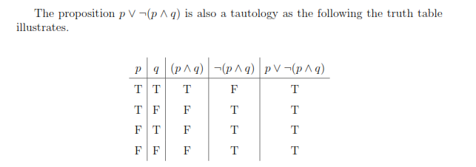
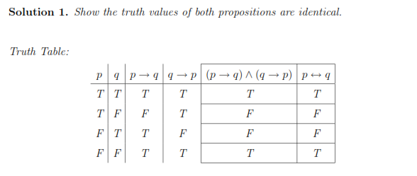

Slide 18
Important Logical Equivalences:
The following logical equivalences apply to any statements;
the p's, q's and r' s can stand for atomic statements or compound statements.
~(~p) ≡p | the Double Negative Law
p ˄q≡ q ˄p | the Commutative Law for conjunction
p ˅q≡ q˅ p | the Commutative Law for disjunction
(p˄ q) ˄ r ≡p˄ (q˄ r) | the Associative Law for conjunction
(p ˅q) ˅r ≡p ˅ (q˅ r) | the Associative Law for disjunction
~(p˅ q) ≡ (~p)˄ (~q) | De Morgan's Laws
~(p ˄q) ≡ (~p)˅ (~q)
p˄ (q˅ r) ≡(p ˄q)˅ (p ˄r) | the Distributive Laws
p˅ (q˄ r) ≡(p˅ q) ˄(p˅ r)
p˄ p ≡p | Absorption Laws
p˅ p ≡p
Applied Discrete Mathematics Week 1: Logic and Sets

Slide 19
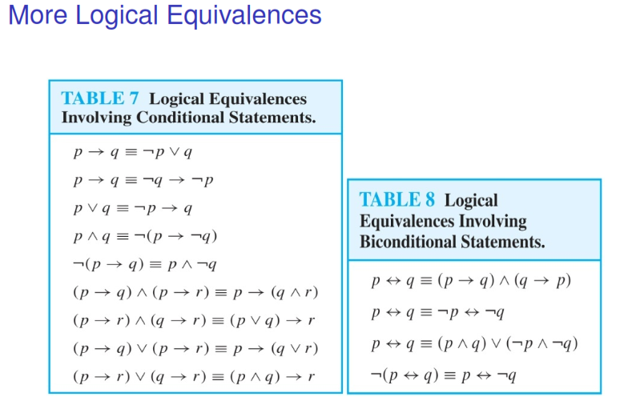
Applied Discrete Mathematics Week 1: Logic and Sets

Slide 20
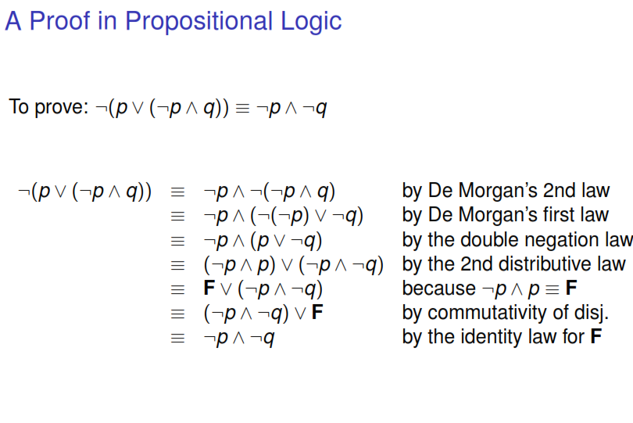

Slide 21
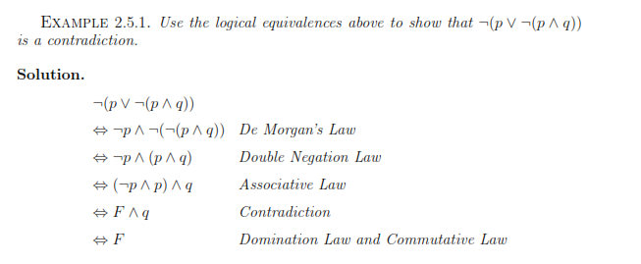
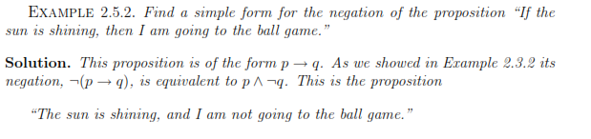

Slide 22
